Slide 1
Aws Providers: How to findout
ow

Slide 2
How to find out resource list??
To find the list of AWS provider resources supported by Terraform, you can refer to the official Terraform documentation for the AWS provider. The documentation provides a comprehensive list of resources along with their attributes and usage examples. Here's how you can access the resource documentation:
Visit the Terraform website: Go to the Terraform website at https://registry.terraform.io/browse/providers
Check the provider documentation for resources, Lets check EC2 launch

Slide 3
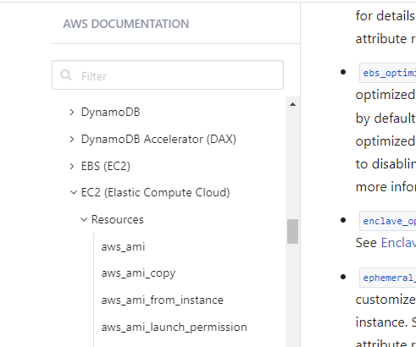
..

Slide 4
..
Explore Resources: In the AWS provider documentation, you will find a navigation menu that lists various categories of AWS resources, such as Compute, Networking, Database, Security, and more.
Browse Resource Documentation: Once you are in the category of your choice, you will see a list of resources supported by the AWS provider. Click on a specific resource to view its documentation.
Alternatively, you can directly access the AWS provider documentation by visiting the following URL: https://registry.terraform.io/providers/hashicorp/aws/latest/docs

